Slide 1
W4111 – Introduction to Databases Section 002, Spring 2024 Lecture 6: ER, Relational, SQL (V)
© Donald F. Ferguson, 2024

Slide 2
W4111 – Introduction to Databases Section 002, Spring 2024 Lecture 6: ER, Relational, SQL (V)
We will start in a couple of minutes.
© Donald F. Ferguson, 2024

Slide 3

Contents
3 | COMS W4111_002_2024_1: Lecture 6: ER, Relational, SQL (V) © Donald F. Ferguson, 2024

Slide 4
Contents
Some Observations
ER (Diagram) Modeling – Aggregation, other notations
SQL Continued (Chapter 3, 4, 5)
Applications and Databases
Project Examples:
Web Applications and REST
Data Engineering and Visualization

Slide 5
Some Observations
5 | COMS W4111_002_2024_1: Lecture 6: ER, Relational, SQL (V) © Donald F. Ferguson, 2024

Slide 6
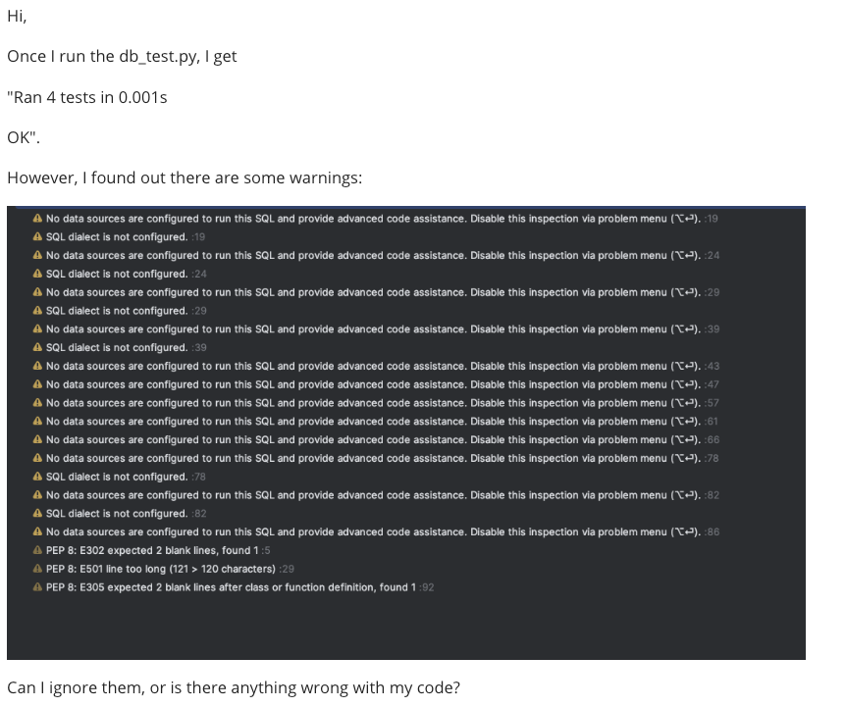
Code Completion and Improvement
Code completion is an autocompletion feature in many integrated development environments (IDEs) that speeds up the process of coding applications by fixing common mistakes and suggesting lines of code. This usually happens through popups while typing, querying parameters of functions, and query hints related to syntax errors. Modern code completion software typically uses generative artificial intelligence systems to predict lines of code. Code completion and related tools serve as documentation and disambiguation for variable names, functions, and methods, using static analysis. (https://en.wikipedia.org/wiki/Code_completion)
Modern integrated development environments parse the code for libraries, database schema, etc. and perform static analsys.
The IDE uses the analysis to
Suggest “completion” while you type.
Display the parameters of a function.
etc.
In this specific case,
PyCharm detects SQL statements in the code.
Does not have a connection to the database → Cannot load and parse schema → Cannot assist.
Note violation of some common style guidelines.

Slide 7
Database design, Entity-Relationship Model Some Complex Examples
7 | COMS W4111_002_2024_1: Lecture 6: ER, Relational, SQL (V) © Donald F. Ferguson, 2024

Slide 8

Aggregation
8 | COMS W4111_002_2024_1: Lecture 6: ER, Relational, SQL (V) © Donald F. Ferguson, 2024

Slide 9
Aggregation
Consider the ternary relationship proj_guide, which we saw earlier
Suppose we want to record evaluations of a student by a guide on a project
(yy5, “XYZ”, dff9)

Slide 10
Aggregation (Cont.)
Relationship sets eval_for and proj_guide represent overlapping information
Every eval_for relationship corresponds to a proj_guide relationship
However, some proj_guide relationships may not correspond to any eval_for relationships
So we can’t discard the proj_guide relationship
Eliminate this redundancy via aggregation
Treat relationship as an abstract entity
Allows relationships between relationships
Abstraction of relationship into new entity

Slide 11
Aggregation (Cont.)
Eliminate this redundancy via aggregation without introducing redundancy, the following diagram represents:
A student is guided by a particular instructor on a particular project
A student, instructor, project combination may have an associated evaluation
The simplest way to handle in relational is an associative entity.
Some thoughts here: https://www.geeksforgeeks.org/aggregate-data-model-in-nosql/
Notes:
11

Slide 12
Reduction to Relational Schemas
To represent aggregation, create a schema containing
Primary key of the aggregated relationship,
The primary key of the associated entity set
Any descriptive attributes
In our example:
The schema eval_for is:
eval_for (s_ID, project_id, i_ID, evaluation_id)
The schema proj_guide is redundant.

Slide 13
Other Notations
Note: Make sure you show ER vs. UML Class Diagrams
13 | COMS W4111_002_2024_1: Lecture 6: ER, Relational, SQL (V) © Donald F. Ferguson, 2024

Slide 14
Summary of Symbols Used in E-R Notation

Slide 15
Symbols Used in E-R Notation (Cont.)

Slide 16
Alternative ER Notations
Chen, IDE1FX, …

Slide 17
Alternative ER Notations
Chen IDE1FX (Crows feet notation)

Slide 18
UML
UML: Unified Modeling Language
UML has many components to graphically model different aspects of an entire software system
UML Class Diagrams correspond to E-R Diagram, but several differences.

Slide 19
ER vs. UML Class Diagrams
* Note reversal of position in cardinality constraint depiction

Slide 20
ER vs. UML Class Diagrams
ER Diagram Notation
Equivalent in UML
* Generalization can use merged or separate arrows independent
of disjoint/overlapping

Slide 21
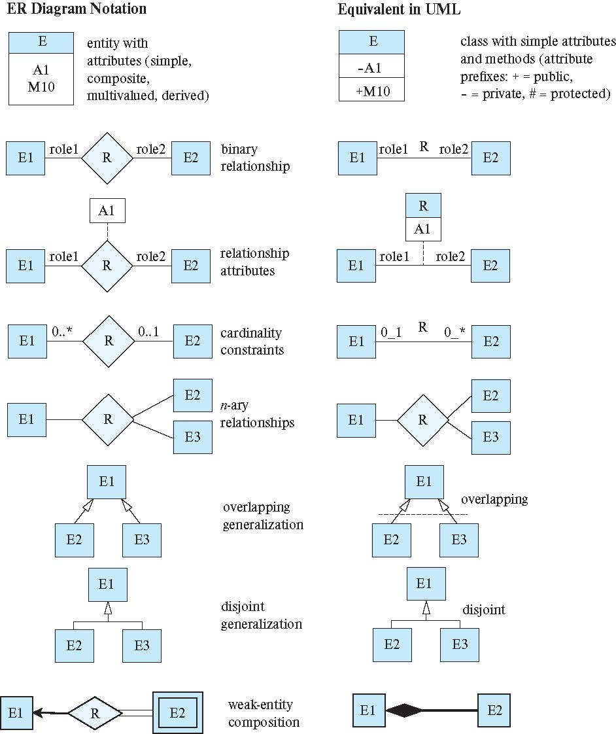
ER vs. UML Class Diagrams

Slide 22
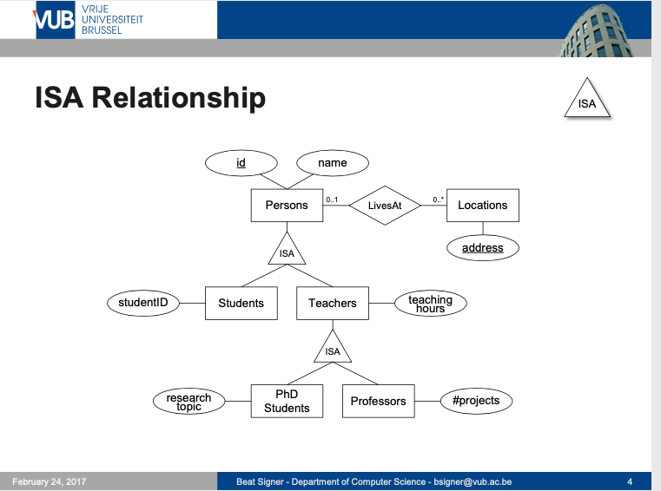
ISA Relationship

Slide 23
ER vs. UML Class Diagrams
ER Diagram Notation
Equivalent in UML
I use this approach in Crow’s Foot Notation but that is not standard.
* Generalization can use merged or separate arrows independent
of disjoint/overlapping

Slide 24
SQL
24 | COMS W4111_002_2024_1: Lecture 6: ER, Relational, SQL (V) © Donald F. Ferguson, 2024

Slide 25
More on Codd’s Rules
25 | COMS W4111_002_2024_1: Lecture 6: ER, Relational, SQL (V) © Donald F. Ferguson, 2024

Slide 26
Codd’s 12 Rules
Rule 4: Active Online Catalog
The structure description of the entire database must be stored in an online catalog, known as data dictionary, which can be accessed by authorized users. Users can use the same query language to access the catalog which they use to access the database itself.
Rule 5: Comprehensive Data Sub-Language Rule
A database can only be accessed using a language having linear syntax that supports data definition, data manipulation, and transaction management operations. This language can be used directly or by means of some application. If the database allows access to data without any help of this language, then it is considered as a violation.
Rule 6: View Updating Rule
All the views of a database, which can theoretically be updated, must also be updatable by the system.
Rule 1: Information Rule
The data stored in a database, may it be user data or metadata, must be a value of some table cell. Everything in a database must be stored in a table format.
Rule 2: Guaranteed Access Rule
Every single data element (value) is guaranteed to be accessible logically with a combination of table-name, primary-key (row value), and attribute-name (column value). No other means, such as pointers, can be used to access data.
Rule 3: Systematic Treatment of NULL Values
The NULL values in a database must be given a systematic and uniform treatment. This is a very important rule because a NULL can be interpreted as one the following − data is missing, data is not known, or data is not applicable.

Slide 27
Codd’s 12 Rules
Rule 10: Integrity Independence
A database must be independent of the application that uses it. All its integrity constraints can be independently modified without the need of any change in the application. This rule makes a database independent of the front-end application and its interface.
Rule 11: Distribution Independence
The end-user must not be able to see that the data is distributed over various locations. Users should always get the impression that the data is located at one site only. This rule has been regarded as the foundation of distributed database systems.
Rule 12: Non-Subversion Rule
If a system has an interface that provides access to low-level records, then the interface must not be able to subvert the system and bypass security and integrity constraints.
Rule 7: High-Level Insert, Update, and Delete Rule
A database must support high-level insertion, updation, and deletion. This must not be limited to a single row, that is, it must also support union, intersection and minus operations to yield sets of data records.
Rule 8: Physical Data Independence
The data stored in a database must be independent of the applications that access the database. Any change in the physical structure of a database must not have any impact on how the data is being accessed by external applications.
Rule 9: Logical Data Independence
The logical data in a database must be independent of its user’s view (application). Any change in logical data must not affect the applications using it. For example, if two tables are merged or one is split into two different tables, there should be no impact or change on the user application. This is one of the most difficult rule to apply.

Slide 28
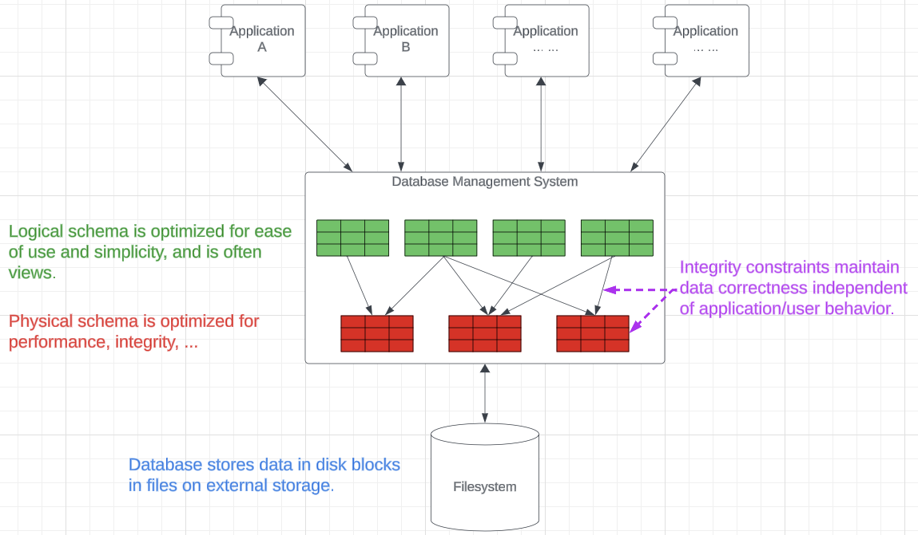
Physical Data, Logical Data, Integrity Independence
Overly simplistic explanation:
Logical Independence:
“Uses views”
Adapts a potentially complex model to how a user “thinks” about the data.
Enables changing the optimized physical model without affecting users – reimplement views.
Physical Independence:
The physical schema is optimized for performance, complex integrity, …
Changes as the application evolves, performance requirements change, etc.
The representation in the database is independent of the physical storage model.
Integrity Independence:
Integrity constraints associated with the database tables/entities partially allows modification without requiring application changes.
Integrity does not rely on correctness of multiple applications and users.

Slide 29
Some Types and Functions
29 | COMS W4111_002_2024_1: Lecture 6: ER, Relational, SQL (V) © Donald F. Ferguson, 2024

Slide 30
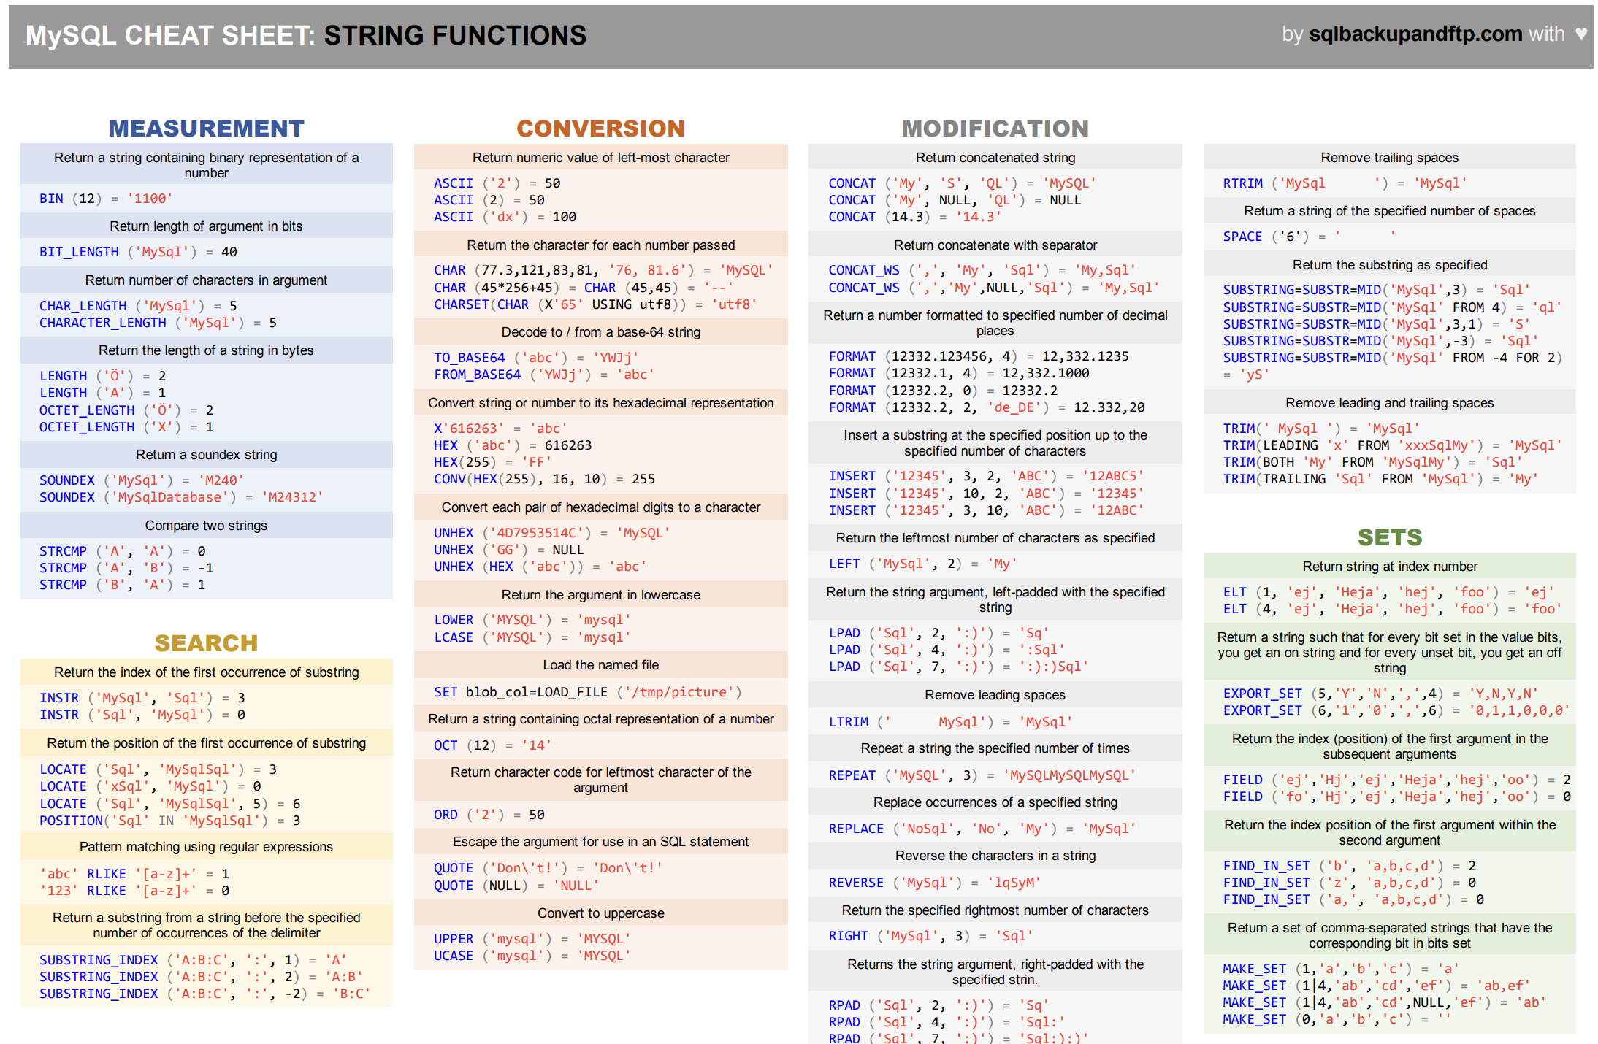
Functions

Slide 31
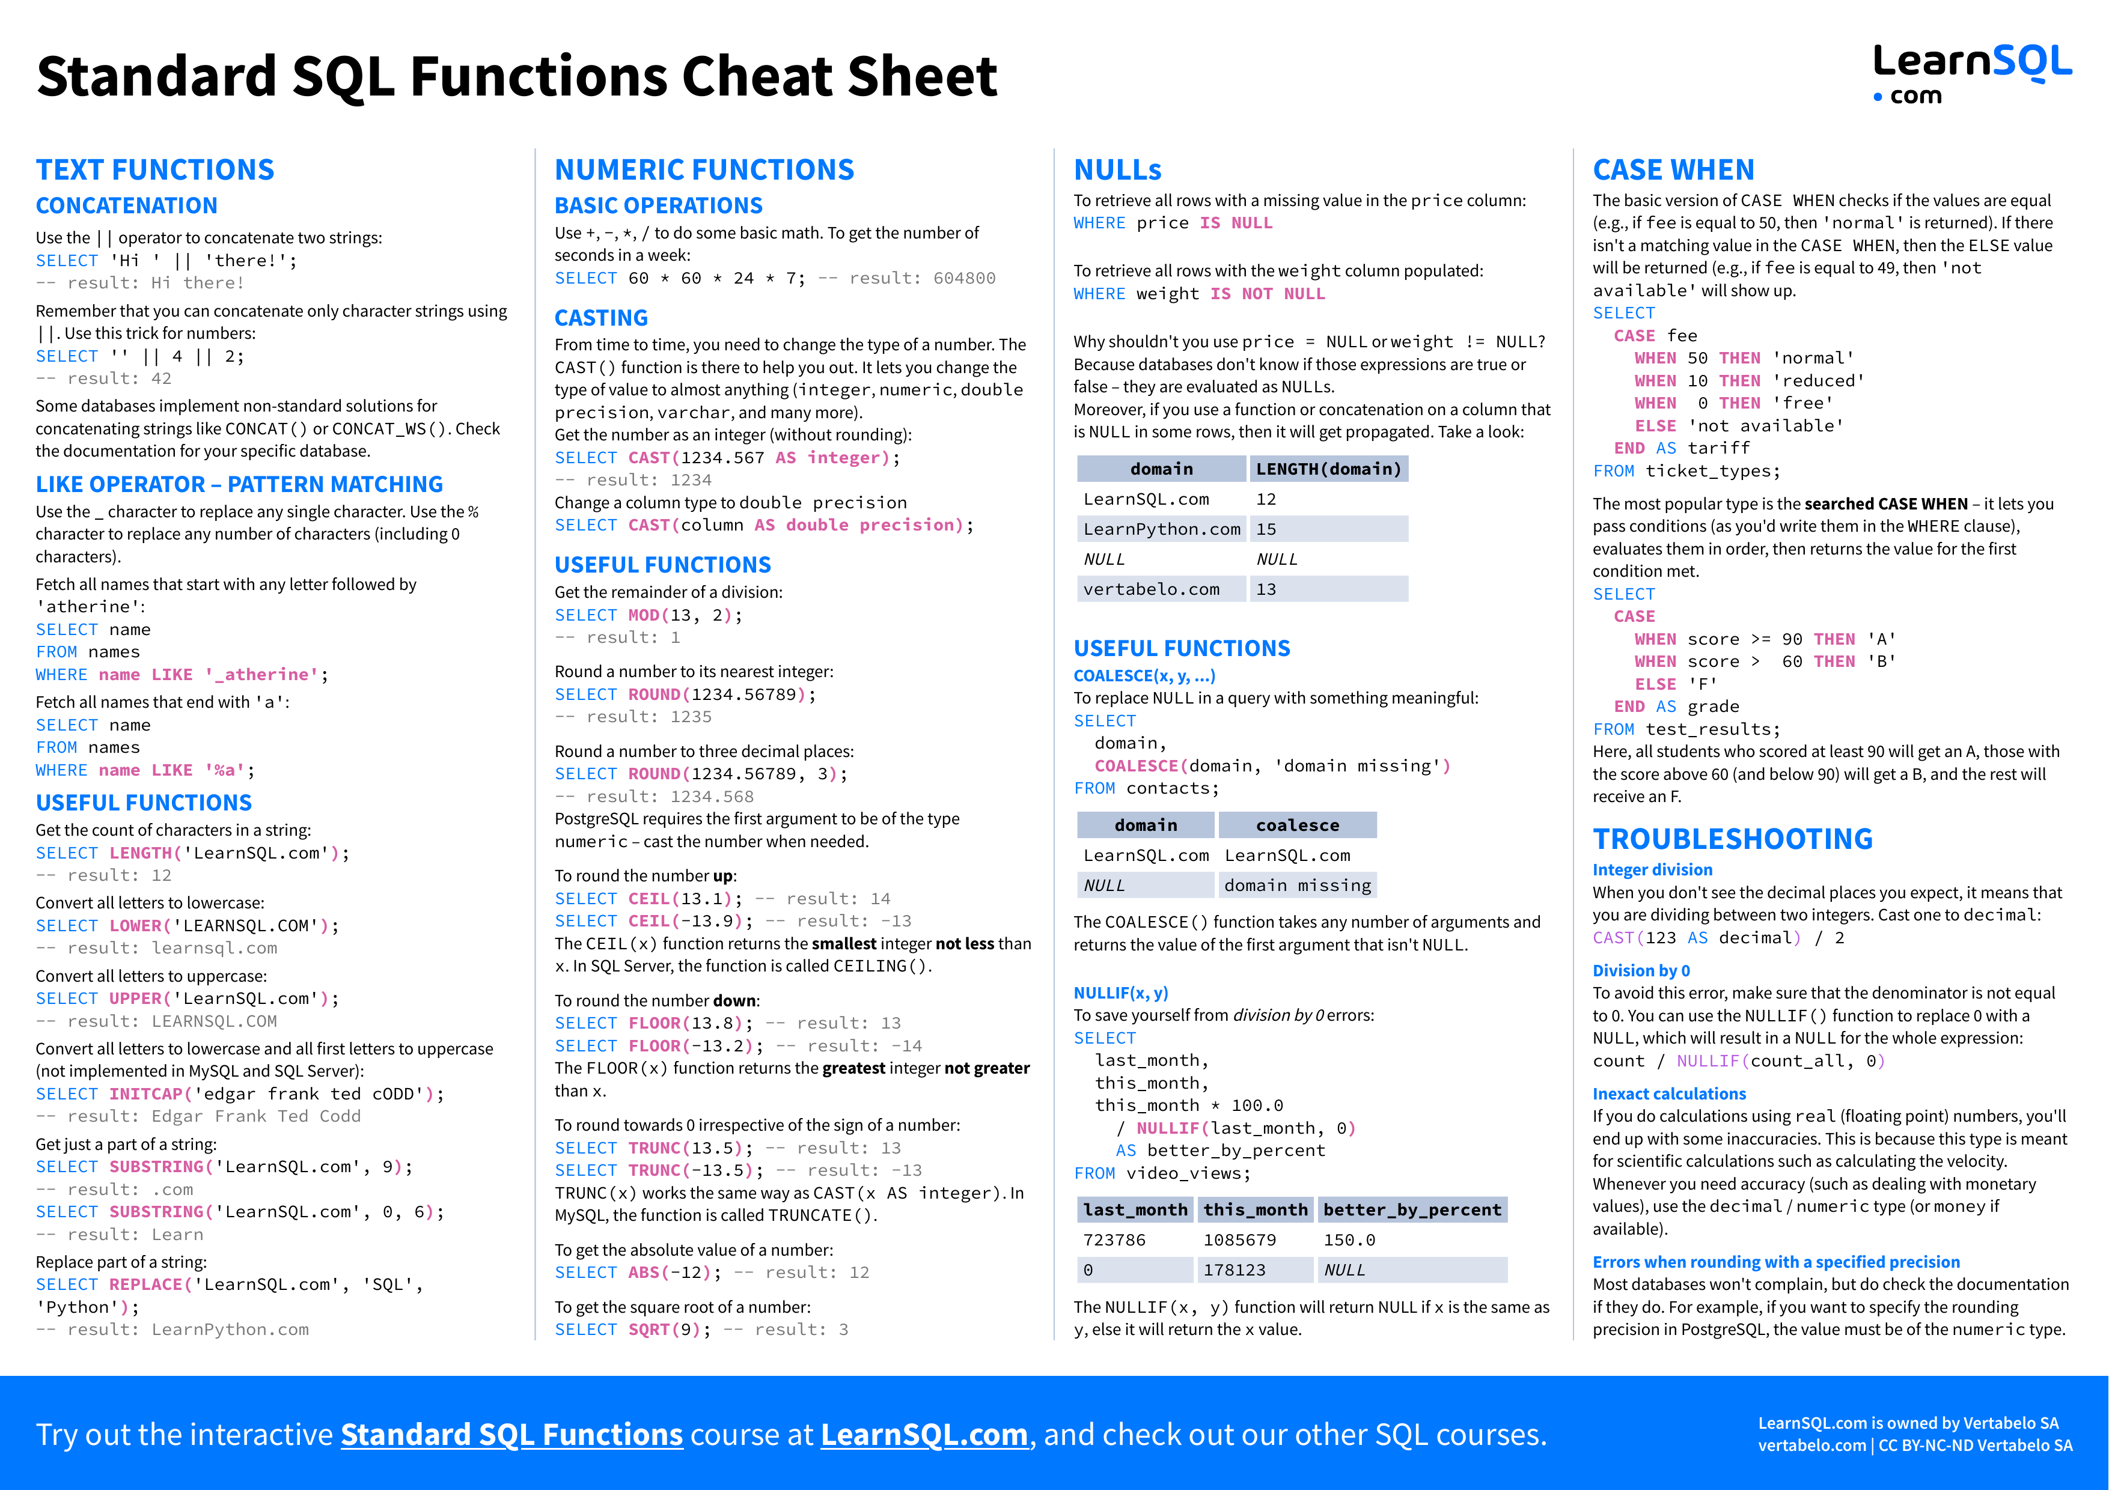
Functions

Slide 32
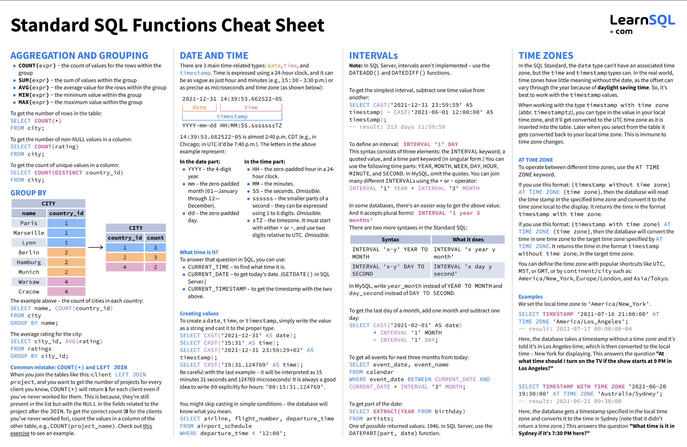
Functions

Slide 33
Functions
The are dozens if not hundreds of standard functions in SQL.
All DBMS implementations have product specific functions.
General rule:
If you have to do something, ask yourself
Am I the first one who ever had to do this?
If the answer is “No,” then ask Dr. Google/ChatGPT.
If the answer is Yes,” ask yourself, “Am I sure this is a good idea.”
The functions are useful and straightforward.
Some examples ➔ To the notebook we go, yo ho!

Slide 34
Integrity Constraints
34 | COMS W4111_002_2024_1: Lecture 6: ER, Relational, SQL (V) © Donald F. Ferguson, 2024

Slide 35
Integrity Constraints
Integrity constraints guard against accidental damage to the database, by ensuring that authorized changes to the database do not result in a loss of data consistency.
A checking account must have a balance greater than $10,000.00
A salary of a bank employee must be at least $4.00 an hour
A customer must have a (non-null) phone number
DFF
Without integrity constraints in the database, maintaining data correctness requires:
Lots of users know what to do and do not make mistakes.
Dozens of programs correctly implement constraints in the code and stay up to date on changes.
Implementing the constraints as part of the schema eliminates many issues.

Slide 36
Constraints on a Single Relation
not null
Primary key
Unique key
check (P), where P is a predicate

Slide 37
Not Null Constraints
not null
Declare name and budget to be not null
name varchar(20) not null budget numeric(12,2) not null

Slide 38
Unique Constraints
unique ( A₁, A₂, …, A_{m})
The unique specification states that the attributes A₁, A₂, …, A_{m} form a candidate key.
Candidate keys are permitted to be null (in contrast to primary keys).

Slide 39
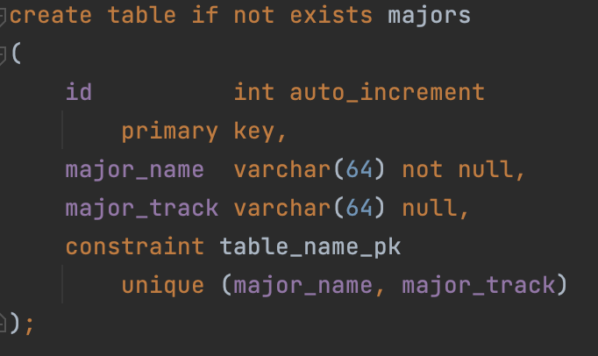
Simple Example
Consider a simple example of an entity class major:
major(id, name, track)
“id” is a uniquely generated ID
“name” is the major name, e.g. “Computer Science,” “Economics,” … …
“track” is a sub-track/specialty within the major, e.g. “Applications,” “AI/ML,” ...
“track” is optional
The combination of (name, track) is unique.
Note: In many DBMS, this automatically creates indices for keys/constraints.
Switch to Notebook.

Slide 40
The check clause
The check (P) clause specifies a predicate P that must be satisfied by every tuple in a relation.
Example: ensure that semester is one of fall, winter, spring or summer
create table section
(course_id varchar (8),
sec_id varchar (8),
semester varchar (6),
year numeric (4,0),
building varchar (15),
room_number varchar (7),
time slot id varchar (4),
primary key (course_id, sec_id, semester, year),
check (semester in ('Fall', 'Winter', 'Spring', 'Summer')))
DFF:
We could handle the semester check with an enum.
Switch to notebook for a slightly different example.

Slide 41
Referential Integrity
Ensures that a value that appears in one relation for a given set of attributes also appears for a certain set of attributes in another relation.
Example: If “Biology” is a department name appearing in one of the tuples in the instructor relation, then there exists a tuple in the department relation for “Biology”.
Let A be a set of attributes. Let R and S be two relations that contain attributes A and where A is the primary key of S. A is said to be a foreign key of R if for any values of A appearing in R these values also appear in S.

Slide 42
Referential Integrity (Cont.)
Foreign keys can be specified as part of the SQL create table statement
foreign key (dept_name) references department
By default, a foreign key references the primary-key attributes of the referenced table.
SQL allows a list of attributes of the referenced relation to be specified explicitly.
foreign key (dept_name) references department (dept_name)

Slide 43
Cascading Actions in Referential Integrity
When a referential-integrity constraint is violated, the normal procedure is to reject the action that caused the violation.
An alternative, in case of delete or update is to cascade
create table course ( (… dept_name varchar(20), foreign key (dept_name) references department on delete cascade on update cascade, . . .)
Instead of cascade we can use :
set null,
set default
DFF:
I do not like using cascade. I think making changes should be explicit.
Other people disagree.
You will get some simple practice on HW or exams.

Slide 44
Indexes Review, Concepts, Examples
44 | COMS W4111_002_2024_1: Lecture 6: ER, Relational, SQL (V) © Donald F. Ferguson, 2024

Slide 45
Index Creation
Many queries reference only a small proportion of the records in a table.
It is inefficient for the system to read every record to find a record with particular value
An index on an attribute of a relation is a data structure that allows the database system to find those tuples in the relation that have a specified value for that attribute efficiently, without scanning through all the tuples of the relation.
We create an index with the create index command
create index <name> on <relation-name> (attribute);

Slide 46
Index Creation Example
create table student (ID varchar (5), name varchar (20) not null, dept_name varchar (20), tot_cred numeric (3,0) default 0, primary key (ID))
create index studentID_index on student(ID)
The query:
select * from student where ID = '12345'
can be executed by using the index to find the required record, without looking at all records of student
DFF:
An index on (column1, column2, column3)
Is also an index on (column1) and (column1, column2)
But not (column2), (column3), (column2, column3).
We will see “why” later in the semester.

Slide 47
(last_name, first_name)
(first_name, last_name)
(last_name, first_name) → cool_kids
(Last_name, first_name) → cool_kids(last_name, first_name)
Index(first_name, last_name)
People JOIN batting
#(people) * #(batting) → 10^5 * 10^6 = 10^11
#(people) * LOG (#(batting)) → 10^5 * 6

Slide 48
Functions, Procedures, Triggers
48 | COMS W4111_002_2024_1: Lecture 6: ER, Relational, SQL (V) © Donald F. Ferguson, 2024

Slide 49
Some Concepts
49 | COMS W4111_002_2024_1: Lecture 6: ER, Relational, SQL (V) © Donald F. Ferguson, 2024

Slide 50
Functions and Procedures
Functions and procedures allow “business logic” to be stored in the database and executed from SQL statements.
These can be defined either by the procedural component of SQL or by an external programming language such as Java, C, or C++.
The syntax we present here is defined by the SQL standard.
Most databases implement nonstandard versions of this syntax.
Note:
The programming language, runtime and tools for functions, procedures and triggers are not easy to use.
My view is that calling external functions is an anti-pattern (bad idea).
External code degrades the reliability, security and performance of the database.
Databases are often mission critical and the heart of environments.

Slide 51
Language Constructs for Procedures & Functions
SQL supports constructs that gives it almost all the power of a general-purpose programming language.
Warning: most database systems implement their own variant of the standard syntax below.
Compound statement: begin … end, {}
May contain multiple SQL statements between begin and end.
Local variables can be declared within a compound statements
While and repeat statements:
while boolean expression do
sequence of statements ;
end while
repeat
sequence of statements ;
until boolean expression
end repeat

Slide 52
(Core) Language Constructs (Cont.)
For loop
Permits iteration over all results of a query
Example: Find the budget of all departments declare n integer default 0; for r as select budget from department where dept_name = 'Music' do set n = n + r.budget end for
Note:
There are various other looping constructs.

Slide 53
(Core) Language Constructs – if-then-else
Conditional statements (if-then-else)
if boolean expression then statement or compound statement elseif boolean expression then statement or compound statement else statement or compound statement end if
Note:
We will not spend a lot of time writing functions, procedures, or triggers.
The language and development environment are not easy to use.

Slide 54
Functions
54 | COMS W4111_002_2024_1: Lecture 6: ER, Relational, SQL (V) © Donald F. Ferguson, 2024

Slide 55
Declaring SQL Functions
Define a function that, given the name of a department, returns the count of the number of instructors in that department.
create function dept_count (dept_name varchar(20)) returns integer begin declare d_count integer; select count (* ) into d_count from instructor where instructor.dept_name = dept_name return d_count; end
The function dept_count can be used to find the department names and budget of all departments with more that 12 instructors.
select dept_name, budget from department where dept_count (dept_name ) > 12

Slide 56
Table Functions
The SQL standard supports functions that can return tables as results; such functions are called table functions
Example: Return all instructors in a given department
create function instructor_of (dept_name char(20))
returns table (
ID varchar(5), name varchar(20), dept_name varchar(20), salary numeric(8,2))
return table (select ID, name, dept_name, salary from instructor where instructor.dept_name = instructor_of.dept_name)
Usage
select * from table (instructor_of ('Music'))

Slide 57
Procedures
57 | COMS W4111_002_2024_1: Lecture 6: ER, Relational, SQL (V) © Donald F. Ferguson, 2024

Slide 58
SQL Procedures
The dept_count function could instead be written as procedure:
create procedure dept_count_proc (in dept_name varchar(20), out d_count integer) begin
select count(*) into d_count from instructor where instructor.dept_name = dept_count_proc.dept_name
end
The keywords in and out are parameters that are expected to have values assigned to them and parameters whose values are set in the procedure in order to return results.
Procedures can be invoked either from an SQL procedure or from embedded SQL, using the call statement.
declare d_count integer; call dept_count_proc( 'Physics', d_count);

Slide 59
SQL Procedures (Cont.)
Procedures and functions can be invoked also from dynamic SQL
SQL allows more than one procedure of the so long as the number of arguments of the procedures with the same name is different.
The name, along with the number of arguments, is used to identify the procedure.

Slide 60
Triggers
60 | COMS W4111_002_2024_1: Lecture 6: ER, Relational, SQL (V) © Donald F. Ferguson, 2024

Slide 61
Triggers
A trigger is a statement that is executed automatically by the system as a side effect of a modification to the database.
To design a trigger mechanism, we must:
Specify the conditions under which the trigger is to be executed.
Specify the actions to be taken when the trigger executes.
Triggers introduced to SQL standard in SQL:1999, but supported even earlier using non-standard syntax by most databases.
Syntax illustrated here may not work exactly on your database system; check the system manuals
X on T
before insert
before update
before delete
after insert
after update
after delete

Slide 62
Triggering Events and Actions in SQL
Triggering event can be insert, delete or update
Triggers on update can be restricted to specific attributes
For example, after update of takes on grade
Values of attributes before and after an update can be referenced
referencing old row as : for deletes and updates
referencing new row as : for inserts and updates
Triggers can be activated before an event, which can serve as extra constraints. For example, convert blank grades to null.
create trigger setnull_trigger before update of takes referencing new row as nrow for each row when (nrow.grade = ' ') begin atomic set nrow.grade = null; end;

Slide 63
Trigger to Maintain credits_earned value
create trigger credits_earned after update of takes on (grade) referencing new row as nrow referencing old row as orow for each row when nrow.grade <> 'F' and nrow.grade is not null and (orow.grade = 'F' or orow.grade is null) begin atomic update student set tot_cred= tot_cred + (select credits from course where course.course_id= nrow.course_id) where student.id = nrow.id; end;

Slide 64
Statement Level Triggers
Instead of executing a separate action for each affected row, a single action can be executed for all rows affected by a transaction
Use for each statement instead of for each row
Use referencing old table or referencing new table to refer to temporary tables (called transition tables) containing the affected rows
Can be more efficient when dealing with SQL statements that update a large number of rows

Slide 65
When Not To Use Triggers
Triggers were used earlier for tasks such as
Maintaining summary data (e.g., total salary of each department)
Replicating databases by recording changes to special relations (called change or delta relations) and having a separate process that applies the changes over to a replica
There are better ways of doing these now:
Databases today provide built in materialized view facilities to maintain summary data
Databases provide built-in support for replication
Encapsulation facilities can be used instead of triggers in many cases
Define methods to update fields
Carry out actions as part of the update methods instead of through a trigger

Slide 66
When Not To Use Triggers (Cont.)
Risk of unintended execution of triggers, for example, when
Loading data from a backup copy
Replicating updates at a remote site
Trigger execution can be disabled before such actions.
Other risks with triggers:
Error leading to failure of critical transactions that set off the trigger
Cascading execution

Slide 67
Summary
67 | COMS W4111_002_2024_1: Lecture 6: ER, Relational, SQL (V) © Donald F. Ferguson, 2024

Slide 68
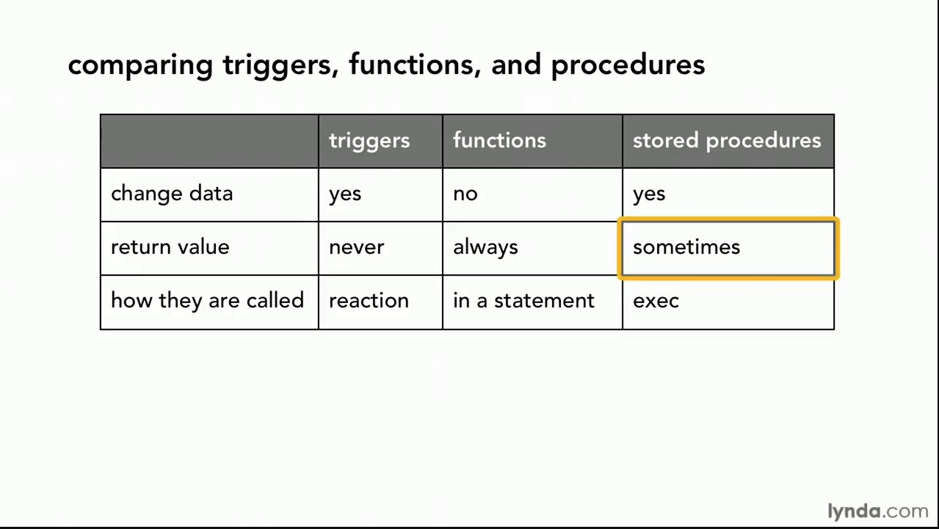
Comparison

Slide 69
Comparison – Some Details
A trigger has capabilities like a procedure, except ...
You do not call it. The DB engine calls it before or after an INSERT, UPDATE, DELETE.
The inputs are the list of incoming new, modified rows.
The outputs are the modified versions of the new or modified rows.

Slide 70
Worked Example – Or Mock Prof. Ferguson While He Codes
70 | COMS W4111_002_2024_1: Lecture 6: ER, Relational, SQL (V) © Donald F. Ferguson, 2024

Slide 71
Scenario
The data model is:
Students
Faculty
An abstract base type Person
We will
Draw the logical and a partial physical ER diagram.
Generate some test data using Mockaroo. We will load the data and create the initial schema.
Give you a bunch of data. --> Load → Tables → constraints
Implement a three-table solution, including indexes, views and constraints.
A function to compute UNIs.
Triggers to automatically assign UNIs.
Stored procedures to create student, faculty.
Disable SQL operations to prevent people from making mistakes.
Snicker at Prof. Ferguson. I put this last, but it will like occur during all steps.

Slide 72
Security
72 | COMS W4111_002_2024_1: Lecture 6: ER, Relational, SQL (V) © Donald F. Ferguson, 2024

Slide 73
Security Concepts (Terms from Wikipedia)
Definitions:
“A (digital) identity is information on an entity used by computer systems to represent an external agent. That agent may be a person, organization, application, or device.”
“Authentication is the act of proving an assertion, such as the identity of a computer system user. In contrast with identification, the act of indicating a person or thing's identity, authentication is the process of verifying that identity.”
“Authorization is the function of specifying access rights/privileges to resources, ... More formally, "to authorize" is to define an access policy. ... During operation, the system uses the access control rules to decide whether access requests from (authenticated) consumers shall be approved (granted) or disapproved.
“Within an organization, roles are created for various job functions. The permissions to perform certain operations are assigned to specific roles. Members or staff (or other system users) are assigned particular roles, and through those role assignments acquire the permissions needed to perform particular system functions.”
“In computing, privilege is defined as the delegation of authority to perform security-relevant functions on a computer system. A privilege allows a user to perform an action with security consequences. Examples of various privileges include the ability to create a new user, install software, or change kernel functions.”
SQL and relational database management systems implementing security by:
Creating identities and authentication policies.
Creating roles and assigning identities to roles.
Granting and revoking privileges to/from roles and identities.

Slide 74
Authorization
We may assign a user several forms of authorizations on parts of the database.
Read - allows reading, but not modification of data.
Insert - allows insertion of new data, but not modification of existing data.
Update - allows modification, but not deletion of data.
Delete - allows deletion of data.
Each of these types of authorizations is called a privilege. We may authorize the user all, none, or a combination of these types of privileges on specified parts of a database, such as a relation or a view.

Slide 75
Authorization (Cont.)
Forms of authorization to modify the database schema
Index - allows creation and deletion of indices.
Resources - allows creation of new relations.
Alteration - allows addition or deletion of attributes in a relation.
Drop - allows deletion of relations.

Slide 76
Authorization Specification in SQL
The grant statement is used to confer authorization
grant <privilege list> on <relation or view > to <user list>
<user list> is:
a user-id
public, which allows all valid users the privilege granted
A role (more on this later)
Example:
grant select on department to Amit, Satoshi
Granting a privilege on a view does not imply granting any privileges on the underlying relations.
The grantor of the privilege must already hold the privilege on the specified item (or be the database administrator).

Slide 77
Privileges in SQL
select: allows read access to relation, or the ability to query using the view
Example: grant users U₁, U₂, and U₃ select authorization on the instructor relation:
grant select on instructor to U₁, U₂, U₃
insert: the ability to insert tuples
update: the ability to update using the SQL update statement
delete: the ability to delete tuples.
all privileges: used as a short form for all the allowable privileges

Slide 78
Revoking Authorization in SQL
The revoke statement is used to revoke authorization.
revoke <privilege list> on <relation or view> from <user list>
Example:
revoke select on student from U₁, U₂, U₃
<privilege-list> may be all to revoke all privileges the revokee may hold.
If <revokee-list> includes public, all users lose the privilege except those granted it explicitly.
If the same privilege was granted twice to the same user by different grantees, the user may retain the privilege after the revocation.
All privileges that depend on the privilege being revoked are also revoked.

Slide 79
Roles
A role is a way to distinguish among various users as far as what these users can access/update in the database.
To create a role we use:
create a role <name>
Example:
create role instructor
Once a role is created we can assign “users” to the role using:
grant <role> to <users>

Slide 80
Roles Example
create role instructor;
grant instructor to Amit;
Privileges can be granted to roles:
grant select on takes to instructor;
Roles can be granted to users, as well as to other roles
create role teaching_assistant
grant teaching_assistant to instructor;
Instructor inherits all privileges of teaching_assistant
Chain of roles
create role dean;
grant instructor to dean;
grant dean to Satoshi;

Slide 81
Authorization on Views
create view geo_instructor as (select * from instructor where dept_name = 'Geology');
grant select on geo_instructor to geo_staff
Suppose that a geo_staff member issues
select * from geo_instructor;
What if
geo_staff does not have permissions on instructor?
Creator of view did not have some permissions on instructor?

Slide 82
Other Authorization Features
references privilege to create foreign key
grant reference (dept_name) on department to Mariano;
Why is this required?
transfer of privileges
grant select on department to Amit with grant option;
revoke select on department from Amit, Satoshi cascade;
revoke select on department from Amit, Satoshi restrict;
And more!
Note:
Like in many other cases, SQL DBMS have product specific variations.
Switch to notebook.

Slide 83
REST
83 | COMS W4111_002_2024_1: Lecture 6: ER, Relational, SQL (V) © Donald F. Ferguson, 2024

Slide 84
Data Modeling Concepts and REST
Almost any data model has the same core concepts:
Types and instances:
Entity Type: A definition of a type of thing with properties and relationships.
Entity Instance: A specific instantiation of the Entity Type
Entity Set Instance: An Entity Type that:
Has properties and relationships like any entity, but ...
Has at least one special relationship – contains.
Operations, minimally CRUD, that manipulate entity types and instances:
Create
Retrieve
Update
Delete
Reference/Identify/... ...

Slide 85
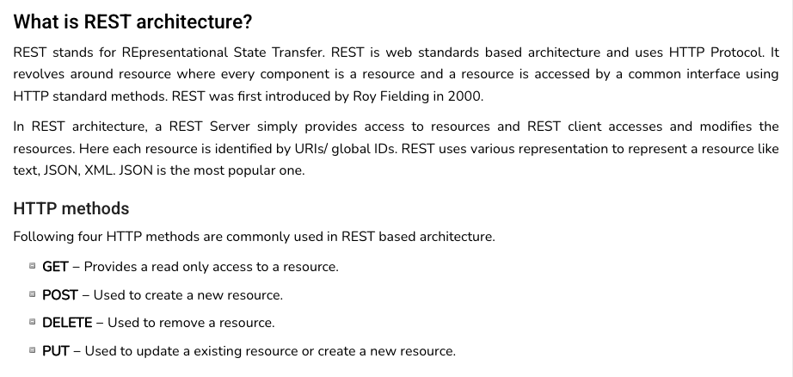
REST (https://www.tutorialspoint.com/restful/restful_introduction.htm)

Slide 86
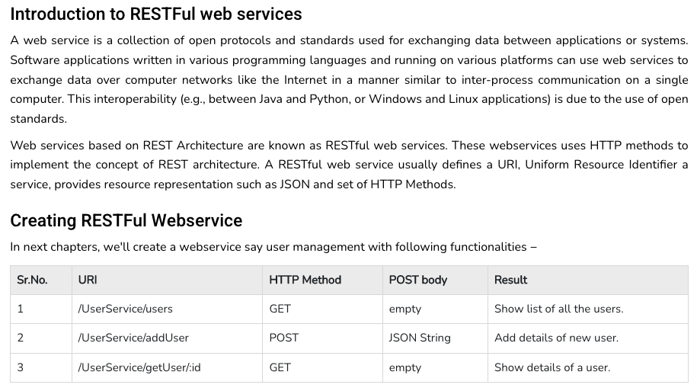
REST (https://www.tutorialspoint.com/restful/restful_introduction.htm)

Slide 87
REST and Resources

Slide 88
URLs

Slide 89
jdbc:mysql://columbia-examples.ckkqqktwkcji.us-east-1.rds.amazonaws.com:3306

Slide 90
Simplistic, Conceptual Mapping (Examples)
REST Method | Resource Path | Relational Operation | DB Resource
DELETE | /people | DROP TABLE | people table
POST | /people | INSERT INTO PEOPLE (...) VALUES(...) | people table people row
GET | /people/21 | SHOW KEYS FROM people ...; SELECT * FROM people WHERE playerID= 21 | people row
GET | /people/21/batting | SELECT batting.* FROM people JOIN batting USING(playerID) WHERE playerID=21
GET | /people/21/batting/2004_1 | SELECT batting.* FROM people JOIN batting USING(playerID) WHERE playerID=21 AND yearID=2004 AND stint=1

Slide 91
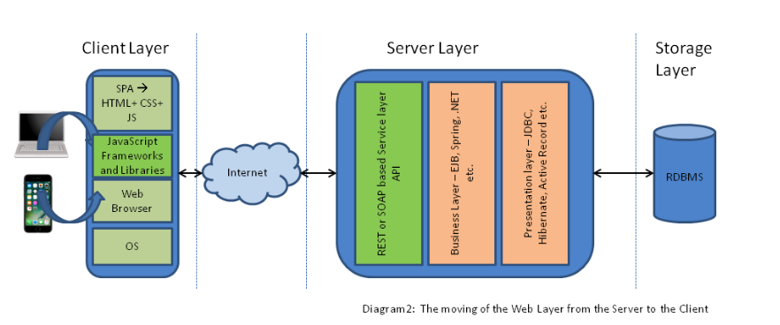
Application Architecture

Slide 92
Sample Projects
92 | COMS W4111_002_2024_1: Lecture 6: ER, Relational, SQL (V) © Donald F. Ferguson, 2024

Slide 93
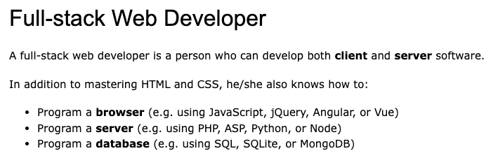
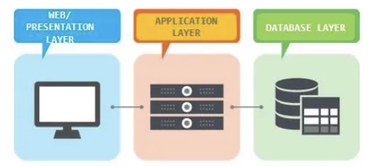
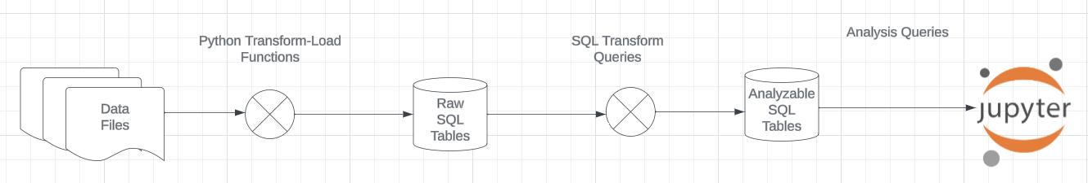
Projects
The programming track will implement a simple, full stack web application.
The non-programming track will implement a data engineering and visualization process in a Jupyter notebook.

Slide 94
Game of Thrones
Bottom-Up Data Mapping:
“Nouns” usually map to Entity/Entity Set.
Nouns inside other nouns often map to:
Attribute
Relationship
Verbs often map to relationships.
Adjectives usually map to properties.
We will start with a subset of the information:
Game of Thrones:
Episodes
Characters
IMDB:
names_basics
title_basics
Entities Sets
Character
Season
Episode
Scene
Location, Sublocation
... ...
Relationships
Character – Scene
Character – Character (e.g. KilledBy)
Season – IMDB Title
Character – IMDB Name
... ...

Slide 95
Game of Thrones
Bottom-Up Data Mapping:
“Nouns” usually map to Entity/Entity Set.
Nouns inside other nouns often map to:
Attribute
Relationship
Verbs often map to relationships.
Adjectives usually map to properties.
We will start with a subset of the information:
Game of Thrones:
Episodes
Characters
IMDB:
names_basics
title_basics
Entities Sets
Character
Season
Episode
Scene
Location, Sublocation
... ...
Relationships
Character – Scene
Character – Character (e.g. KilledBy)
Season – IMDB Title
Character – IMDB Name
... ...
IMDB: https://developer.imdb.com/non-commercial-datasets/
Do not download.
Despite being “tiny” compared to the reall world.
The datasets are too big for most laptops.
Game of Thrones: https://github.com/jeffreylancaster/game-of-thrones

Slide 96
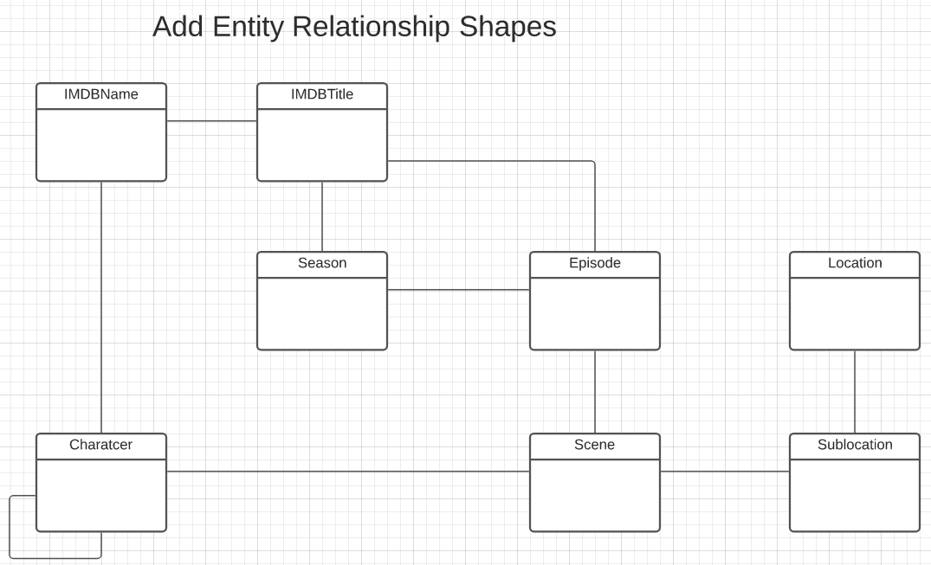
Game of Thrones – Conceptual Model
Add shapes in Lucidchart ...
With a little
Data exploration
Common sense
Judgment/experience
I came to this conceptual model.
Attributes unspecified
Relationship required/cardinality unspecified.
A little more exploration is needed.

Slide 97
Sample Projects
Walkthrough of Web Apps:
/Users/donaldferguson/Dropbox/000/000-A-Current-Examples/W4111-FastAPI-IMDB-Solution
/Users/donaldferguson/Dropbox/000/000-A-Current-Examples/current-dashboard
Data Engineering:
/Users/donaldferguson/Dropbox/000/000-Columbia/2024-Spring/W4111-Intro-to-Databases-Spring-2024/Lectures/s-2024-Lecture-3/More-Data-Engineering.ipynb
And others.
Sample Notebook on GoT.

